Slide 1

Sandip
University
School Of Computer Science and Engineering
Department of Science and Application
Academic Year 2024-25
CIA-3 Presentation
On
“Prioritize Me”
By
Mr. Smaran Pankaj Palshikar
SY BCA-A
230105011026

Slide 2
Prioritize Me
Help yourself

Slide 3
Contents
Introduction
Operating Environment
Features
Scope
Conclusion
Output

Slide 4
Introdution
PrioritizeMe is an innovative and user-friendly to-do list app designed to help users manage tasks, set priorities, and boost productivity. It offers advanced features like smart reminders, customizable categories, and many more features to ensure tasks are completed on time and in the right order. Unlike traditional to-do lists, PrioritizeMe allows users to organize tasks based on priority, helping reduce stress and improve goal achievement. With its intuitive design and cross-platform support, PrioritizeMe is the ideal tool for individuals seeking to stay organized and on track with personal and professional commitments.

Slide 5
Operating Environment
1.5.1. Software Specification:
Programming Language: Python 3.x
GUI Framework: Tkinter (for building cross-platform UIs)
Database: MySQL (for storing tasks and data)
mysql-connector-python(for connecting Python to MySQL)
Development Tools:
IDE: Visual Studio Code, PyCharm, or Sublime Text
Package Management: pip, virtualenv
Database Management: MySQL Workbench (for managing MySQL database)

Slide 6
Operating Environment
1.5.2. Hardware Specification:
For Development:
CPU: Intel Core i5 (or equivalent AMD)
RAM: 8GB (min 4GB)
Storage: 100GB free space (SSD recommended)
OS: Windows, macOS, or Linux
For MySQL Database:
Local Machine: Install MySQL for development.
Cloud Hosting (for production): AWS, DigitalOcean, or similar for scalable MySQL database.
Testing: Mobile/Emulator: Android/iOS device or emulator for testing

Slide 7
Here are features that can be extracted from the Task data model:
Feature Name | Type | Description
Task Title | Text | Main label of the task
Description Length | Numeric | Length of the task description in characters or words
Due Date | Date | When the task should be completed
Days Until Due | Numeric | due_date - current_date
Priority Level | Categorical | Low, Medium, High
Category | Categorical | Work, Personal, Fitness, etc.
Completion Time | Time Delta (Optional) | Time taken from creation to completion (if tracked)

Slide 8
Features
The Prioritize Me app will enable users to create, manage, and organize tasks. It will support features such as task categorization, reminders, and collaboration. The app will be designed for individual users and small teams.
Top Features Such As:
Categorization
Search/filter functions
Voice Input
Reminder for task due

Slide 9
Scope
The scope of the PrioritizeMe to-do list application is to provide an effective and user-centric task management solution tailored for individuals—including students, professionals, and homemakers—as well as small teams seeking to collaborate on projects. The application’s core functionalities include task creation, viewing, completion, deletion, voice-enabled task management, task prioritization, categorization, reminders, and productivity tracking, complemented by options for interface customization to enhance user experience.
Planned future enhancements encompass collaboration features, integration with external productivity tools (such as calendars and emails), and analytics for productivity insights. PrioritizeMe is designed for cross-platform deployment across iOS, Android, and web platforms, with a strong focus on delivering an intuitive and accessible user interface.
In terms of security, the application will implement robust data protection measures, secure authentication, and compliance with data privacy regulations to safeguard user information. Overall, PrioritizeMe aims to support diverse task management needs while remaining adaptable to future technological advancements and user requirements.

Slide 10
Conclusion
PrioritizeMe is a powerful and user-friendly to-do list application built with Python, Tkinter, TkinterMD, and MySQL. It offers a responsive, cross-platform interface with a modern, Material Design-inspired look, allowing users to efficiently create, edit, delete, and prioritize tasks. With reliable MySQL-based data storage, PrioritizeMe helps users stay organized and focused. While the app covers essential task management needs, future enhancements like cloud syncing, mobile support, AI-based prioritization, collaboration features, and push notifications could expand its capabilities, making it a fully integrated productivity solution for modern users.

Slide 11
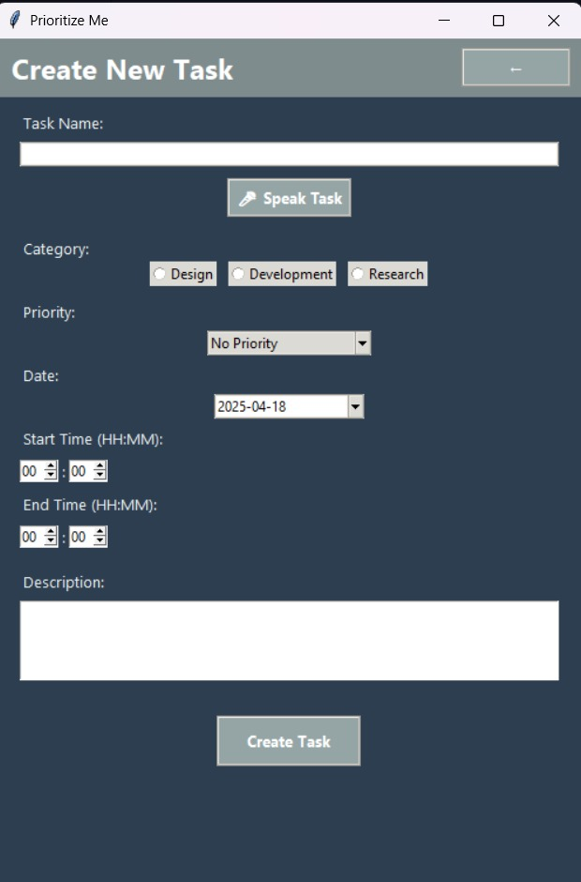
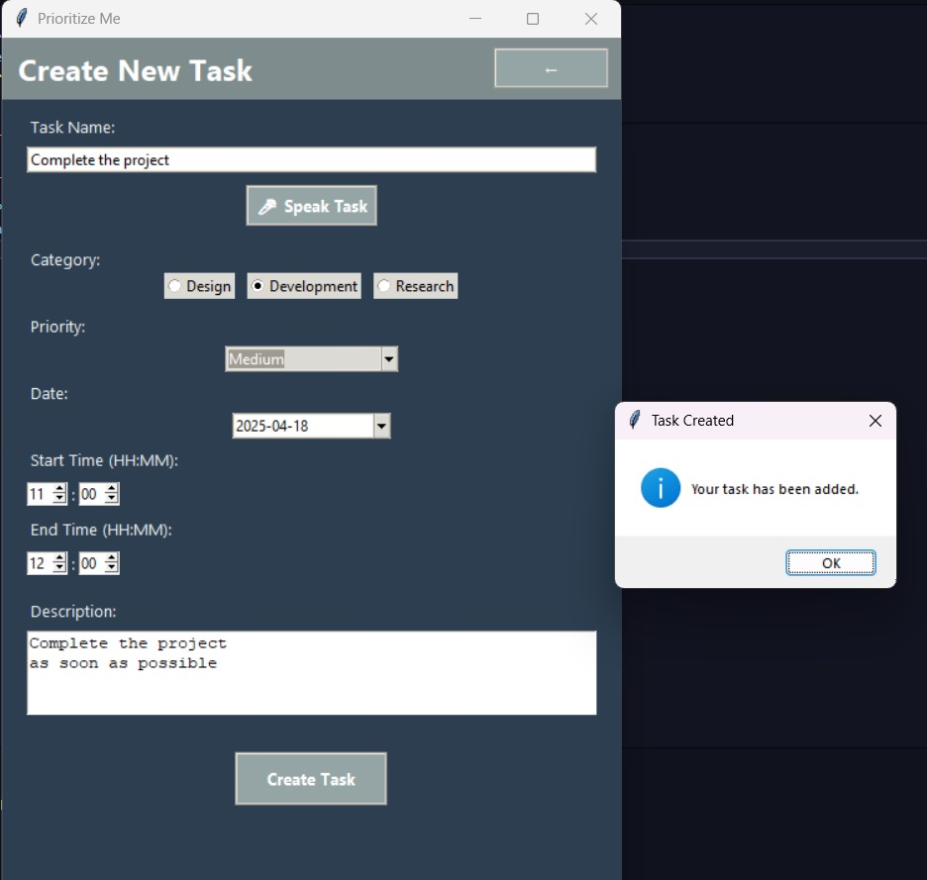
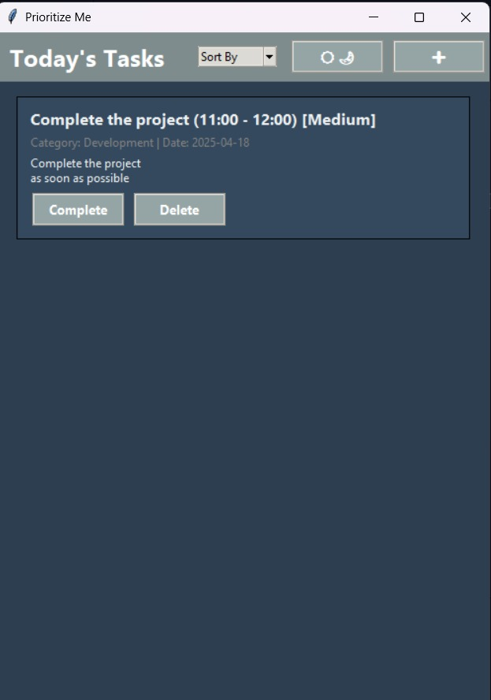
Output

Slide 12
Thank You….
Name: Smaran Palshikar
Prn: 230105011026
SYBCA A1
Prioritize Me

